Slide 1

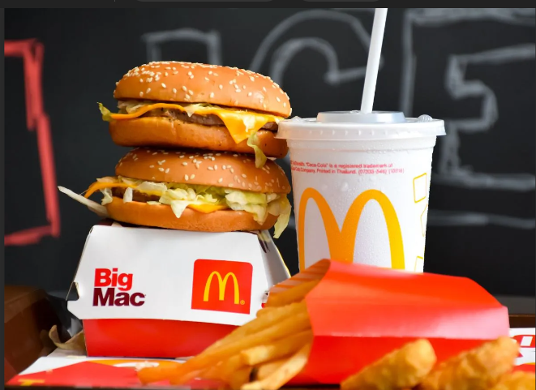
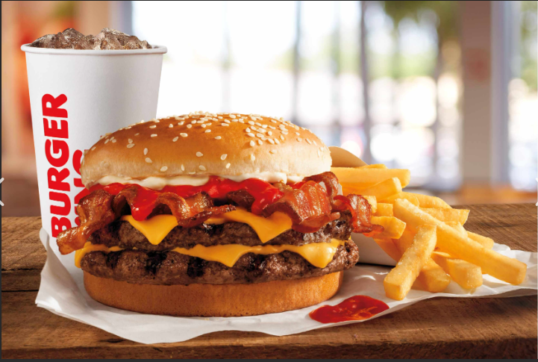
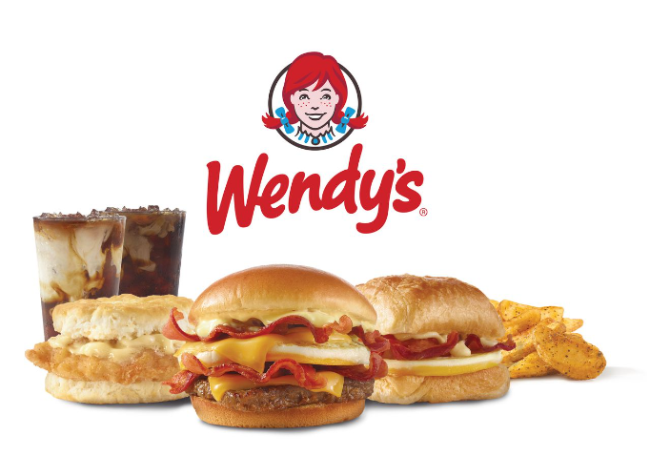
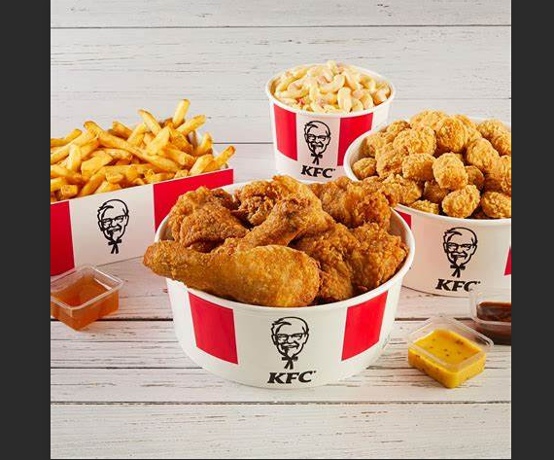
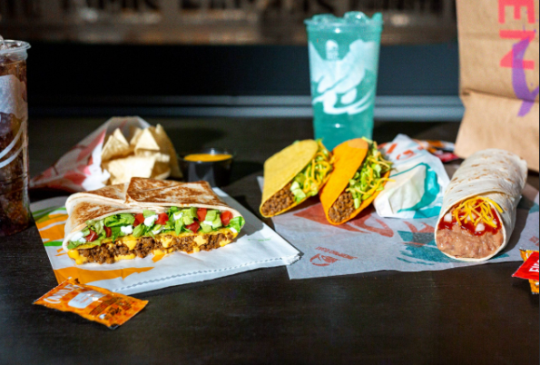
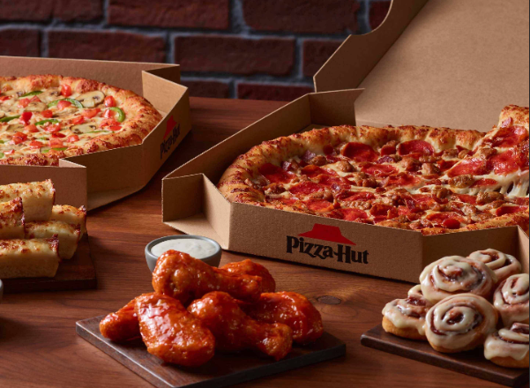
Fast food restaurant’s nutritional values
Creators: James Brannan, John Haynes, Pamala Cox, and Mereissa Henrie
Notes:
Good evening everyone this is teams 7 project 3 presentation.

Slide 2
For our project, we worked with a nutritional Kaggle dataset covering the Nutritional values, including Calories and Micro-nutrients, from six of the largest and most popular fast-food restaurants: McDonald’s, Burger King, Wendy’s, Kentucky Fried Chicken (KFC), Taco Bell, and Pizza Hut. It provides data on their food items offerings including Calories, Calories from Fat, Total Fat, Saturated Fat, Trans Fat, Cholesterol, Sodium, Carbs, Fiber, Sugars, Protein, and Weight Watchers Points (were available). We looked at the dataset in various ways including:
References: (Code: Xpert Learning Assistant, prior boot camp act.,)
Dataset: Fast Food Nutrition (kaggle.com), Fast Food Nutrition
Notes:
At the bottom of the slide you can see our references and our dataset.
For our project

Slide 3
Whether one restaurant has a higher volume of high-caloric foods than others.
Which food items have the highest/lowest caloric values?
Using scatterplots to compare different categories (grams of sugar > calories, cholesterol > calories, grams of protein > grams of sugar, etc.
Ultimately, our interactive visualization hopes to build a tool for users to make better decisions on which food items to select if they patronize any of these establishments.

Slide 4
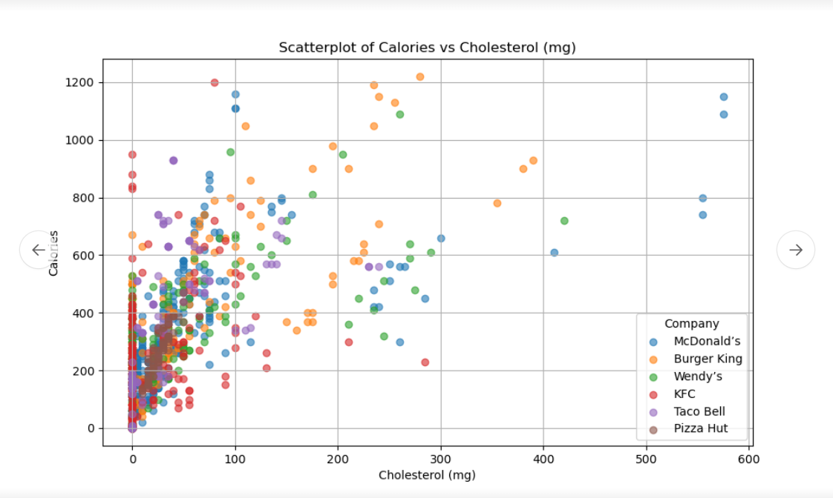
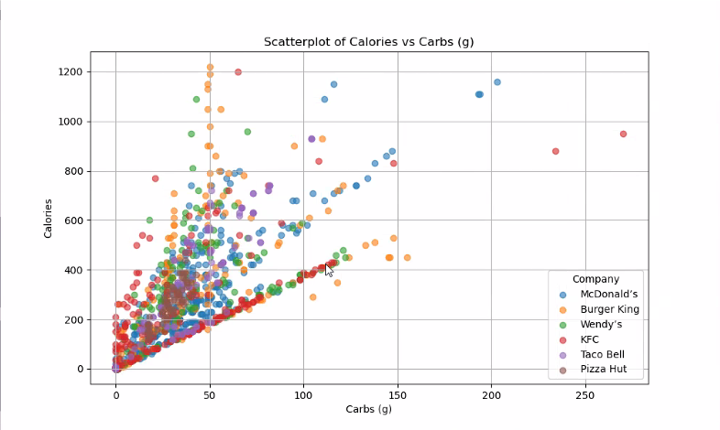
Calories vs Carbs
Calories vs Cholesterol (mg)
Notes:
What is healthy?
There is a lot of information that could support a variety of health needs.
Here we have Carbs and Cholesterol
Are you on a low Carbs Diet?
Do you need to watch your Cholesterol for heart health?
Many dietary requirements are unique to a given person

Slide 5
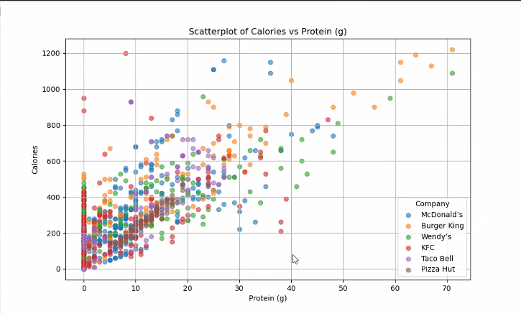
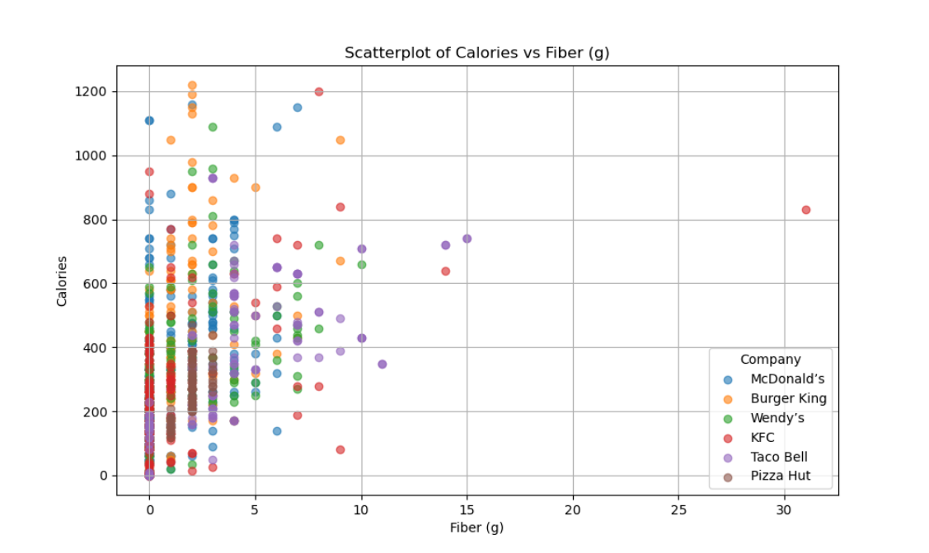
Calories vs Fiber (g)
Calories vs Protein (g)
Notes:
Need a high fiber diet?
That may be very tricky in this restaurants, but it can be doable with the right selection.
What about a high Protein?
You may be able to get that high protein, but at what cost? As you can many of these items are below 20g
To each their own need.

Slide 6
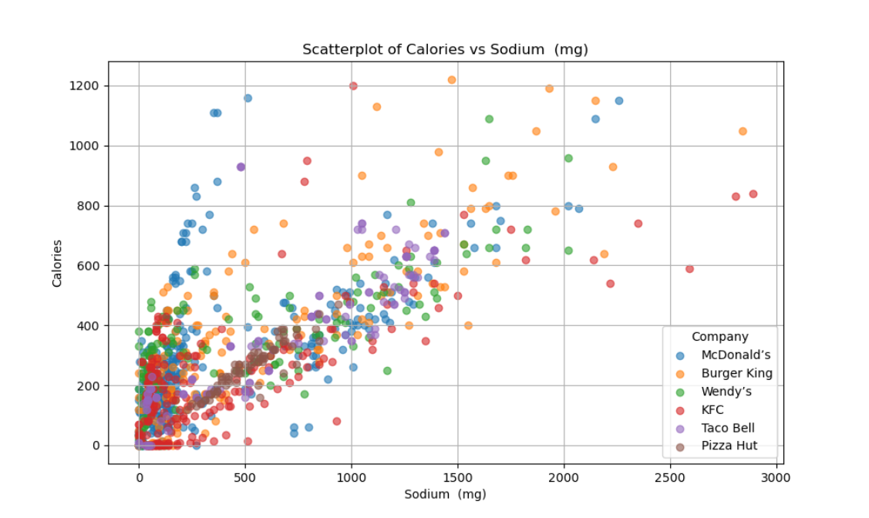
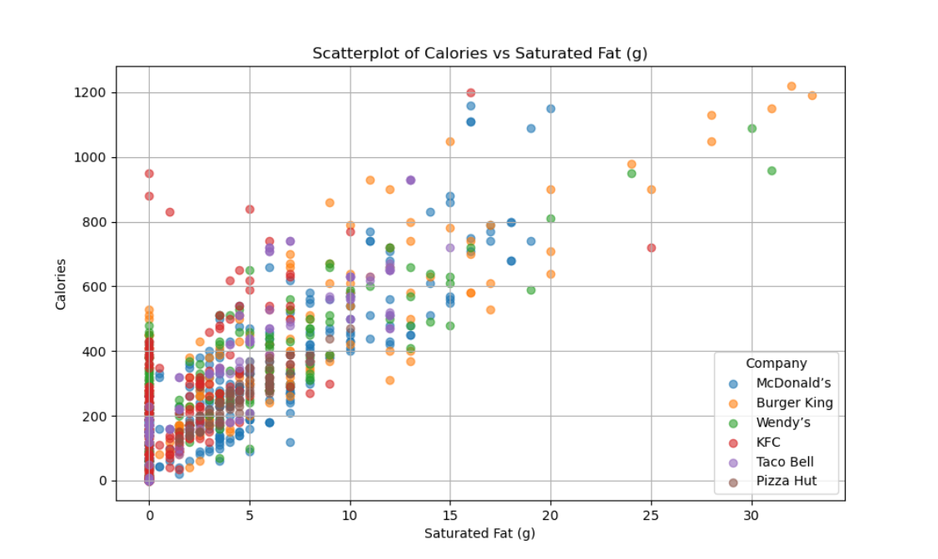
Calories vs Saturated Fat (g)
Calories vs Sodium
Notes:
We are talking about fast food and nutrition, so we must include Saturated Fats and Salts.
A low sodium diet is common health concern for many individuals.

Slide 7
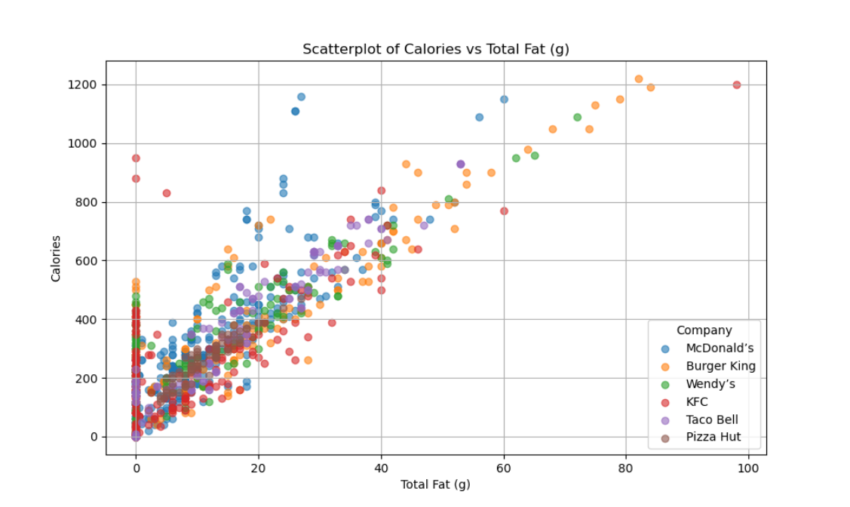
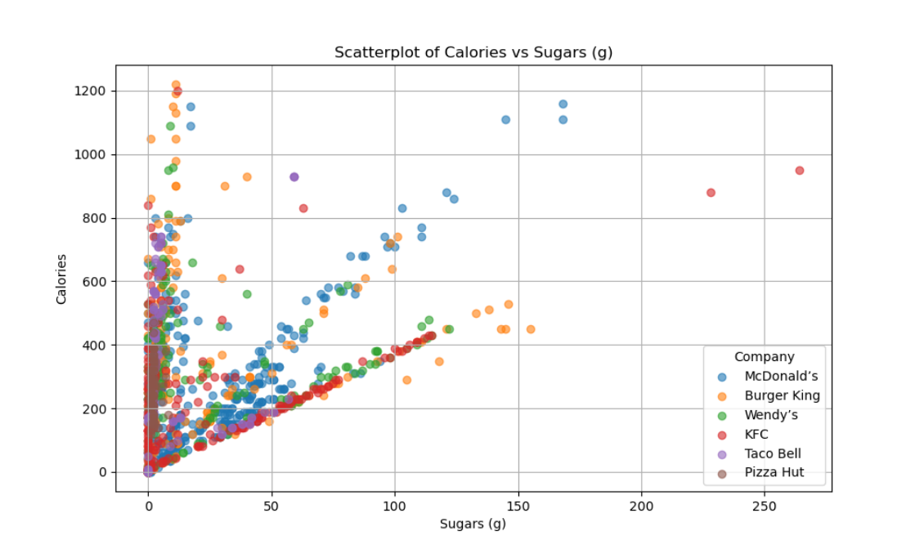
Calories vs Sugars (g)
Calories vs Total Fat (g)
Notes:
A diabetic person needs to not just avoid sugars, but also carbohydrates.
While much of this falls below the 50g mark it is important to consider that these numbers are for just 1 item, and not a meal.

Slide 8
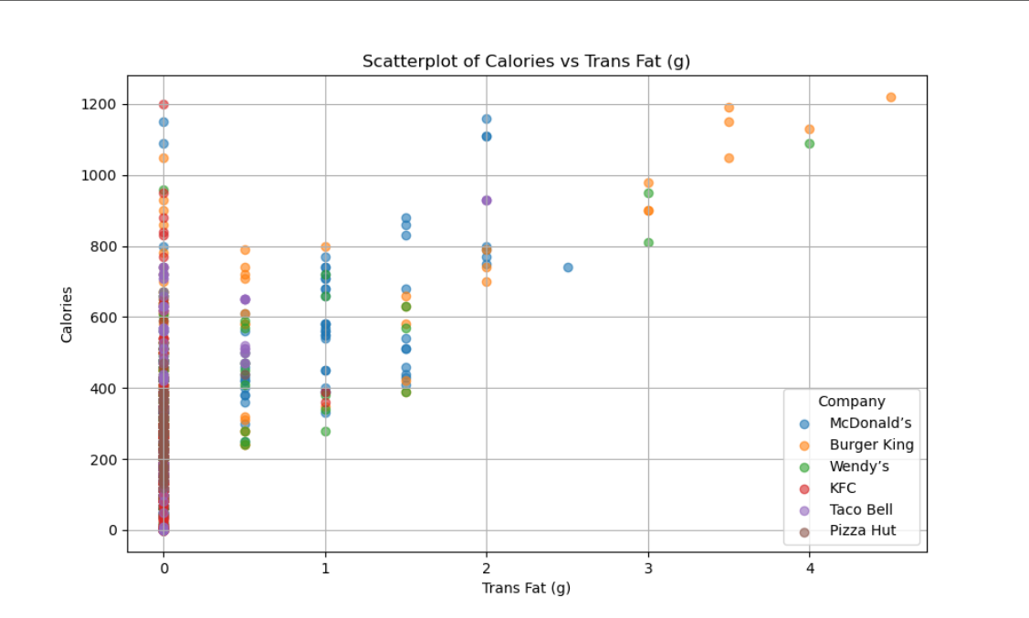
Calories vs Trans Fat (g)
Notes:
Here you see Calories vs Trans fats.
While it may seem to have large selection without trans fats, it is important to consider that they are only located in liquid oils turned into solid fats, like French fries, fried foods etc.

Slide 9
Teams 7 Website:
Notes:
Closing

Slide 10
Conclusion:
Despite facing some challenges in getting our Fast-Food Nutrition Dashboard to look exactly as intended, the process has demonstrated several key benefits that can be valuable in an interview with a recruiter or hiring manager.
Problem-solving:
Technical Proficiency:
User-Centric Design:
Adaptability and Learning:
Team Collaboration
Resourcefulness
Notes:
Closing

Slide 11
Ethical statement:
In our Data Visualization project related to fast food nutrition, we have made extensive efforts to ensure ethical considerations are upheld throughout the research and analysis process. Our primary focus has been on the accurate representation of data to avoid misleading conclusions. We have sourced our nutritional information from reputable and verified databases, ensuring that all data is current and fact-checked. Privacy concerns have been meticulously addressed by anonymizing any user-generated data to protect individual identities. Additionally, we have made it a priority to present our findings in a manner that is accessible and understandable to a broad audience, avoiding technical jargon that could confuse or mislead non-experts. We have also been mindful of the potential implications of our visualizations, striving to promote awareness and informed decision-making without stigmatizing any particular fast-food brand or dietary choice. Our project includes disclaimers about the limitations of the data and encourages users to consult with healthcare professionals for personalized dietary advice.
Notes:
This is our Ethical statement:

Slide 12
Any questions
Notes:
Closing

